Slide 1
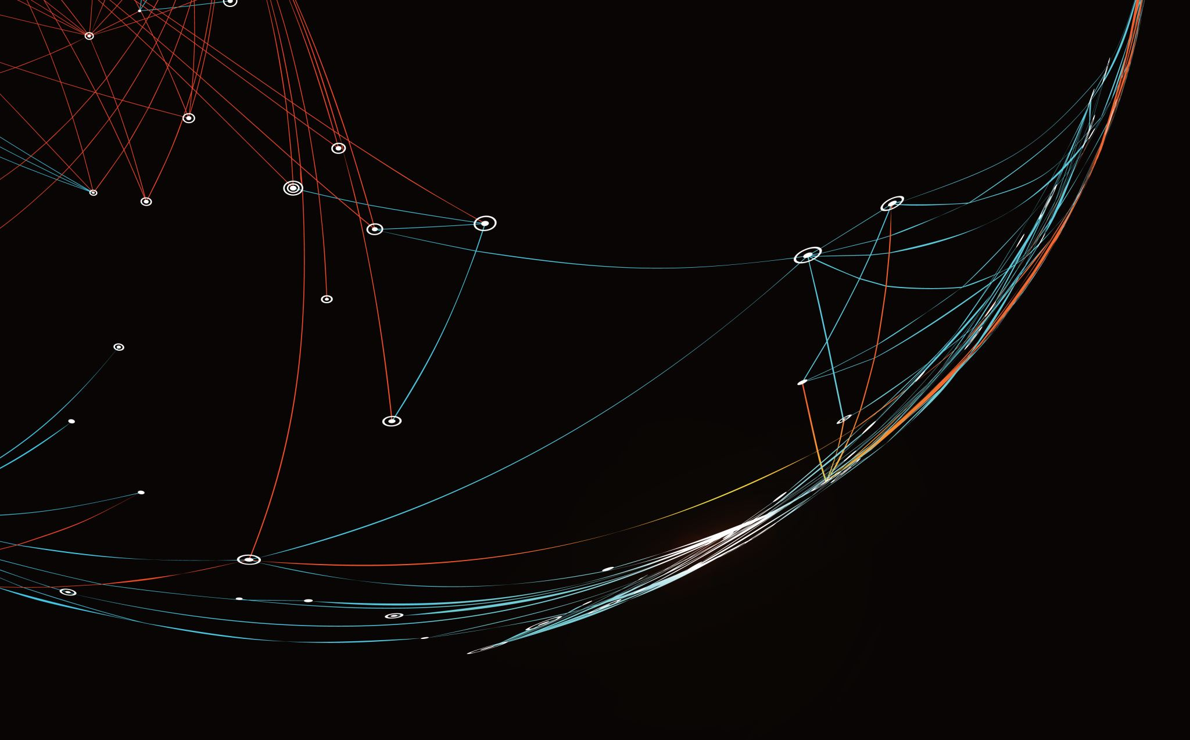
Security Assessment and Risk Management
Week 8 – Residual Risk

Slide 2
Residual Risk
Vulnerability is a weakness brought about by a lack of controls.
Mitigation refers to the action taken to reduce the risk, such as fixing the fence. Mitigation can be partial or whole. Mitigation basically reduces the risk to an acceptable level.
Residual Risk refers to the remaining risk after mitigation is performed. For example, people can still use a ladder to climb the fence, or use a tank to plow through the fence.

Slide 3
Remember risk perspectives
Asset-based is identifying risks based on what can happen to your assets.
Outcomes-based is identifying what can happen to your desired outcomes, such as profits, income, or sales.
Process-based is focused on safety outcomes.
Vulnerability-based is centered around inherent weaknesses.
Threat-based revolves around who can perform the attacks.

Slide 4
Inherent risk
The amount of risk an asset carries in the absence of controls.
Residual risk = Inherent risk – Mitigation from controls
Inherent risk = Threat score * Impact score / 5

Slide 5
It is a car analogy
As a residual risk example, you can consider the car seat belts.
Initially, without seatbelts, there were a lot of deaths and injuries due to accidents.
After the seat belts were installed in the cars and made mandatory to wear by the law, there was a significant reduction in deaths and injuries.
However, there are still injuries and deaths by the accidents even after the driver wears these seat belts; this could be said as a residual risk.
The seat belts have been successful in mitigating the risk, but some risk is still left, which is not captured; that is why there are deaths by accident.

Slide 6
Step 1: Identify the inherent risk factor.
First, determine the recovery time objective (RTO) for the business unit. Though there may be two, three, four, or more processes associated with a particular unit, the residual risk formula considers only the RTO of the most critical process. So if Process A needs to be recovered in 24 hours and Process B is 48 hours, evaluate the business recovery plan for the unit using only the RTO for Process A.
The RTOs of each business unit and their business processes should have been uncovered as part of the BIA process.

Slide 7
Step 1: Identify the inherent risk factor.
Next, determine the business impact score. Each RTO category has a level of potential business impact associated with it. A critical business unit with a very short recovery timeframe indicates a high level of criticality and would therefore have a significant impact on the business should a disruption occur versus a business unit with a much longer recovery timeframe. Each RTO would have a corresponding impact score associated with it, such as:
1 = Insignificant Impact
2 = Minimal Impact
3 = Moderate Impact
4 = Critical Impact
5 = Catastrophic Impact

Slide 8
Example
If, for example, the RTO of a call center is identified as 12 hours or less, this typically indicates a highly critical process. Based on the criticality assessment, the call center plan would get a business impact score of 4 or 5.

Slide 9
Step 1: Identify the inherent risk factor.
Evaluate the natural, human-made, and technological threats facing the business unit. Is it in a high-risk area geographically (for any reason)? Are its processes especially vulnerable to attack? Assign a threat-level score to the unit, with 5 being high, 3 being moderate, and 1 being low.
Multiply the business impact score and the threat landscape score; then divide by 5. The resulting number is the plan’s inherent risk level.
Scores will range anywhere from 2.0 to 5.0. A score between 4 and 5 means that the plan has high inherent risk. A score between 3 and 3.9 has moderate inherent risk. Anything lower than that has low inherent risk.

Slide 10
Step 2: Identify management’s level of risk tolerance.
First, educate management. Management will be unfamiliar with the concept of residual risk calculation and its significance. It’s up to you to explain to the management team how it works and why it’s important.
Next, advise management on an acceptable level of risk tolerance. Based on the level of inherent risk, assign a percentage to indicate how much risk your management team should be willing to accept, for example:
If the inherent risk factor is between 4 and 5—10% (low risk tolerance).
If the inherent risk factor range is between 3 and 3.9—15% (moderate risk tolerance).
If the inherent risk factor is less than 3—20% (high risk tolerance).
The lower the percentage, the tighter your controls should be. The more effort you put into it, the better your chance of recovery will be

Slide 11
Step 2: Identify management’s level of risk tolerance.
Finally, calculate management’s level of risk tolerance. Multiply the percentage of risk tolerance times the inherent risk factor. The resulting score is your risk tolerance.
Based on an inherent risk factor (business impact score) of 5, we identified our level of risk tolerance as low (10%). Multiply the risk factor by the risk tolerance (10% x 5); that’s 0.5. So, your maximum risk tolerance is 0.5. To get your risk factor-tolerance score, subtract 0.5 from 5; that’s 4.5. This means our mitigating controls must be in a state that their level of capability adds up to 4.5 or better to be within tolerance.

Slide 12
Step 3: Assess and score your mitigating controls.
First, assign weights to your mitigating controls based on their importance.
Controls should be weighted based on how important each one is to the success of the plan. Ex. A recovery strategy (the plan you actually have in place to recover a particular business unit) and recovery exercises (the practice you’ve had testing the plan and its ability to help you recover).

Slide 13
Step 3: Assess and score your mitigating controls.
Next, evaluate each of your mitigating controls against the standards. Is your recovery plan in line with the recommendations outlined in the standards? Depending on how well each control stands up to the recommended qualifications, give it either a 1 (poor), 3 (average), or 5 (best practice).
Finally, determine the weighted score of your mitigating controls. For each control, multiply the score times the weight. Then, add up those results to come up with one overall score for your mitigating controls (your mitigating control state).

Slide 14
Remember mitigation strategies
#1 – Avoid the Risk
No doing the thing that results in risk.
#2 – Risk Reduction
Doing things to reduce the impact and likelihood of a risk.
#3 – Risk Transfer
Insuring or sub-contracting the risk.
#4 – Risk Acceptance
Choosing or being forced to operate with the risk.

Slide 15
Step 4: Calculate your residual risk.
To complete the residual risk formula, compare the mitigating control state to the risk factor-tolerance number. Look at the resulting number. How close is it to the risk factor-tolerance number? If it’s equal to or higher than the risk factor-tolerance number, you are well within tolerance range. The business recovery plan you’ve created is right on the mark.
If the number is lower than your risk tolerance, the plan is insufficient. Depending on how far off the mark you are, you’ll have to take further action to improve the strength of your business recovery plan.

Slide 16
Countering residual risk
Identify governance, risk, and compliance requirements and formulate policy for the same.
Define the organization’s risk appetite, its capacity to take risks, and resilience to losses in case of an event.
Identify and take necessary action to offset the unacceptable risk.
Buy insurance against losses to transfer the risk.
Accept the risk (risk registry) as it is and maintain a resource buffer.
Identify and mitigate all known risks to the Company.

Slide 17
Example: Call Center Risk Assessment
High
Medium Risk
High Risk
Loss of phones
Loss of computers
Credit risk
Customer has a long wait
Customer can’t get through
Customer can’t get answers
I
M
P
A
C
T
Low Risk
Medium Risk
Fraud
Lost transactions
Employee morale
Entry errors
Equipment obsolescence
Repeat calls for same problem
Low
PROBABILITY
High

Slide 18
Scenario 1
A small, growing bank was cited for noncompliance by a regulatory agency because its information security program did not have an independent review. It seems that although a review was performed, it was conducted by an operations officer because he had network administrative access and was the only individual with the expertise to complete the review.
Where is the lapse in effective IT governance in this situation?
What do you think could have been done to prevent this bank from being in this situation?
Notes:
The actual risk here is the lack of segregation of duty. The operations officer with network administrative access is, by default, not independent because he or she has regular access to the system.
If the bank had the proper IT organizational structure and resource management in place, including proper segregation of duties and duty controls, this situation may not have occurred.

Slide 19
Security Games
Nash Game
Nash equilibrium provides solution of a non-cooperative game involving two or more players. Here, each player knows the best strategies of other players that lead to the equilibrium. However, none of them can gain more than the received payoff by changing only their own strategies.
Stackelberg Games
Stackelberg Security Game (SSG) is a leader-follower model where the leader (defender) acts first and then the follower (attacker) chooses the best response.
Stackelberg vs. Nash in Security Games
In Nash games, players can change strategies at any point. However, in Stackelberg games, the leader always acts first and the reward of the leader is always greater than the followers. That means, in a SSG, the defender’s payoff is always greater than the payoff received by the attacker while playing the best response.

Slide 20
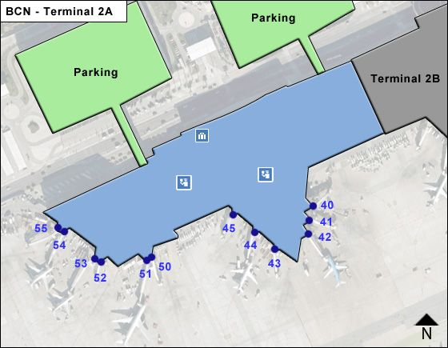
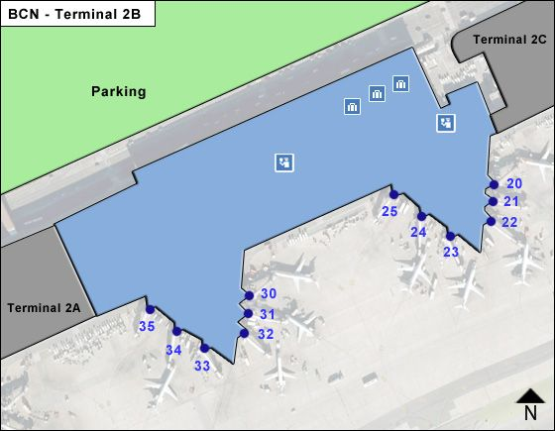
Security example
Terminal A
action
Terminal B
action

Slide 21
Security game
A
B
A
0, 0 | -1, 2
-1, 1 | 0, 0
B

Slide 22
Example security game
3 airport terminals to defend (A, B, C)
Defender can place checkpoints at 2 of them
Attacker can attack any 1 terminal
A
B
C
{A, B}
0, -1 | 0, -1 | -2, 3
0, -1 | -1, 1 | 0, 0
-1, 1 | 0, -1 | 0, 0
{A, C}
{B, C}

Slide 23
Strategy Summary
For the attacker, malicious nodes can choose not to attack to build trust, causing the probability of a defender node starting the IDS to decrease
When the cost of starting the IDS is high, the attacker needs to attack
Rational defender will increase probability of starting IDS when intruded nodes are detected
Strategies make full user of limited resources and provides effective security protection
Notes:
For a rational attacker, when the attack doesn’t happen, the malicious nodes can imitate the normal nodes to participate in normal network activity for the
sake of more trust from other nodes. CTw will increase with the increasing of the degree of credibility.
With the increasing of CTw , the δi will be reducing.
For a rational defender when the cost of starting the IDS CTm is large, defenders will try to reduce starting the IDS.
As a result, attackers must increase the probability of attacking.
With the increase of CTm, σi will be increasing.
In this attack-defense game model, in every period T , defenders need to re-evaluate the previous stage of the payoffs to formulate a new defense strategy (δi, 1 − δi ).
In the initial stage, to each node with larger CTw , the probability of starting the IDS is lower.
Once intruded nodes are detected, nodes close to the intrusion quickly reduce the value of CTw and improve the probability of starting the IDS to increase the defense rating.
When a period of time without intrusion occurs, each node will gradually increase the values of CTw to reduce the probability of starting the IDS.
Nodes in ESNs are changing between attackers’ and defenders’ strategies in a dynamic balance, which makes full use of the limited resources and provides effective security protection at the same time.

Slide 24
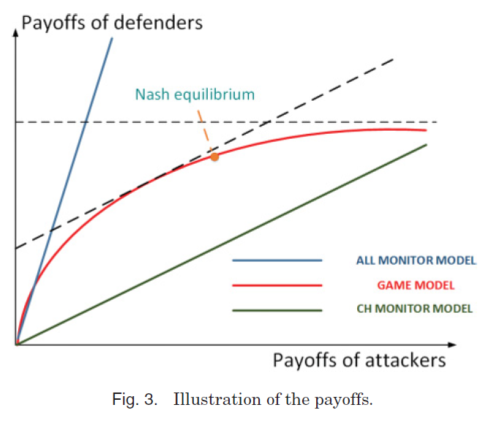
Payoff Analysis
Notes:
As a rational defender, excessive protection cannot bring extra payoffs to the network.
Meanwhile, as a rational attacker, excessive frequency of attacking is not a long-term strategy

Slide 25
Game Tree Model for Error Detection and Missing Detection
Graphical representation of a sequential game
Defines players, payoffs, strategies, and order of moves
Nodes (or vertices) are points at which players can take actions
Edges represent the actions that may be taken at that node

Slide 26
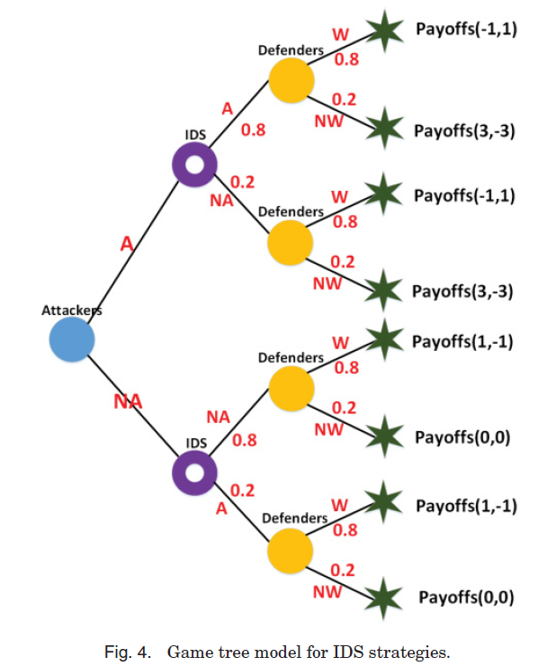
Game Tree Model for Error Detection and Missing Detection
Notes:
SA = {NA, A} represents attackers’ strategies,
wherein NA represents not attack and A represents attack.
SI = {NW,W} represents defenders’ strategies,
wherein NW represents not alert and W represents alert.
For example, we assume the IDS’s detection results mixed probability matrix:
P =
0.8 0.2
0.2 0.8
A game tree is a graphical representation of a sequential game. It provides information
about the players, payoffs, strategies, and order of moves. The game tree consists of
nodes (or vertices), which are points at which players can take actions, connected by
edges, which represent the actions that may be taken at that node
.

